Slide 1

Bankruptcy Prediction Project
MGMT 571
Team Name: LearningMachine
Final Position on Kaggle: 1

Slide 2

What we tried – Pre-processing
Data Partition : We tried 60-40, 70-30 and 80-20 splits, and 80-20 was seen to give best results as the model had more data to train on
Outlier handling: Replacement using MAD was the logical choice given the skewed nature of several predictors. This also gave us the best results on the leaderboard. It was done only for tree-based models.
Variable transformations: We tried binning and log transformation, but the results were not encouraging. Hence, we chose to go without any transformation.

Slide 3
What we tried – Models
Gradient boosted trees model: 500 trees with max depth of 6, learning rate of 0.05. Sampled 80% of the training data for each tree. The aim was to train at a slow rate and over many sequential trees.
Ensemble model:
GBDT model mentioned in the first point
AutoNeural model with 5 hidden layers, max iterations = 8, activation functions = tanh, softmax, identity, logistic, normal (auto-picked by SAS)
HP Neural: 3 hidden layers, 10 neurons in each layer, all using tanh activation function, target activation function = identity, input standardization = z-score, max iterations = 300, number of tries = 50
We experimented with logistic regression and random forest, but the score on the Public Leaderboard was not encouraging, so we submitted the above 2 models

Slide 4
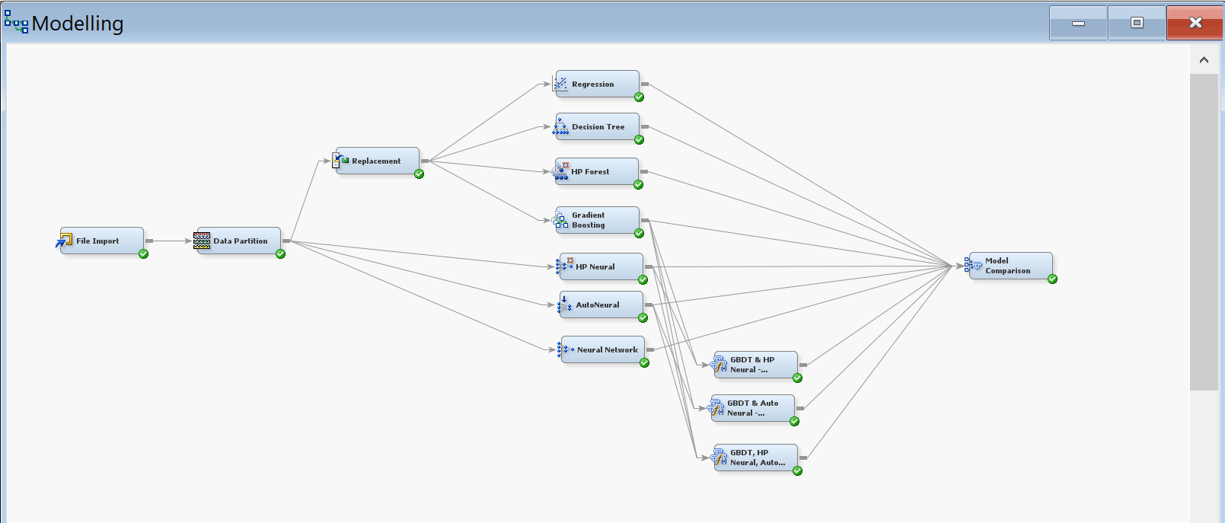
SAS EM Diagram

Slide 5
What worked!
MODEL 1 – Gradient Boosted Decision Trees
Training ROC = 1, Validation ROC = 0.921, Public LB = 0.930, Private LB = 0.948
Intuition: This model performed consistently well on 2 sets of unseen data; hence we were confident of its performance on the Private LB
MODEL 2 – Ensemble of GBDT, HP Neural, AutoNeural
Training ROC = 1, Validation ROC = 0.917, Public LB = 0.952, Private LB = 0.983
Intuition: This model performed consistently well on 2 sets of unseen data; hence we were confident of its performance on the Private LB. There was a big jump in score from Validation ROC to Public LB score.
For both models, we retrained the models on the entire training set before submitting on Kaggle. This was expected to improve performance further as it had more data to learn from.

Slide 6
What did not work (Unsubmitted)
(Another) Ensemble model - GBDT, HP Neural, AutoNeural
Training ROC = 0.969, Validation ROC = 0.924, Public LB = 0.938, Private LB = 0.942
Intuition: Although this model performed consistently across all datasets, the expected increase in Public LB score from Validation ROC was not encouraging
Logistic Regression models
We initially experimented with some logistic models as well, but they were consistently giving a Public LB score of around 0.9. These models were outperformed our later models (Ensemble and GBDT).

Slide 7
Learnings
We found that GBDTs can be trained better by reducing the learning rate and increasing the number of trees, and by keeping the max depth at a reasonable level (in our case 6)
For imbalanced datasets, GBDT models naturally place more focus on misclassified (often minority class) samples in subsequent trees, giving them higher weights during training
Ensemble model worked best as it averaged out the results from 3 different good models. The models improved on each other’s weaknesses and as a combined model, was able to reduce the overall prediction error.
The AutoNeural model worked well as it allowed us to specify certain tuning parameters and SAS EM itself was able to design the architecture to give us the best results
We were worried about overfitting due to the ~1 training ROC for the submitted models, but these models still performed consistently well on changing the random seed and on unseen data, and they performed well on the Private LB also

Slide 8
THANK YOU!

